Slide 1
College Board: Creating Your College List
College Prep
Mr. Gordon
jgordon@bisdtx.org

Slide 2
Upcoming Events
Monday, Sept. 6th Labor Day Holiday for CRCA and ACC
Tuesday, Sept. 7th CRCA Holiday, 10th and 12th still have ACC
*I will email today with bus schedule*
Friday, Sept. 17th Student Council Elections
*Officer applications are due by Friday, Sept. 3rd*

Slide 3
What to consider when choosing a College:
Most Important Considerations:
Location
Size
Program/ Degree Offerings
Cost
Where do you fit in?
Other
Considerations:
Graduation Rate
Housing
Legacy
Religion
Relationship

Slide 4

College Board: Creating Your College List
Using the criteria on the previous slide and what you learned from last week’s College Prep, we are going to create YOUR College List.

Slide 5
College Board: Creating Your College List
When applying for colleges your senior year, you should plan on
applying to 3-5 universities.
For this activity, you will add 10 to your College Board list.

Slide 6
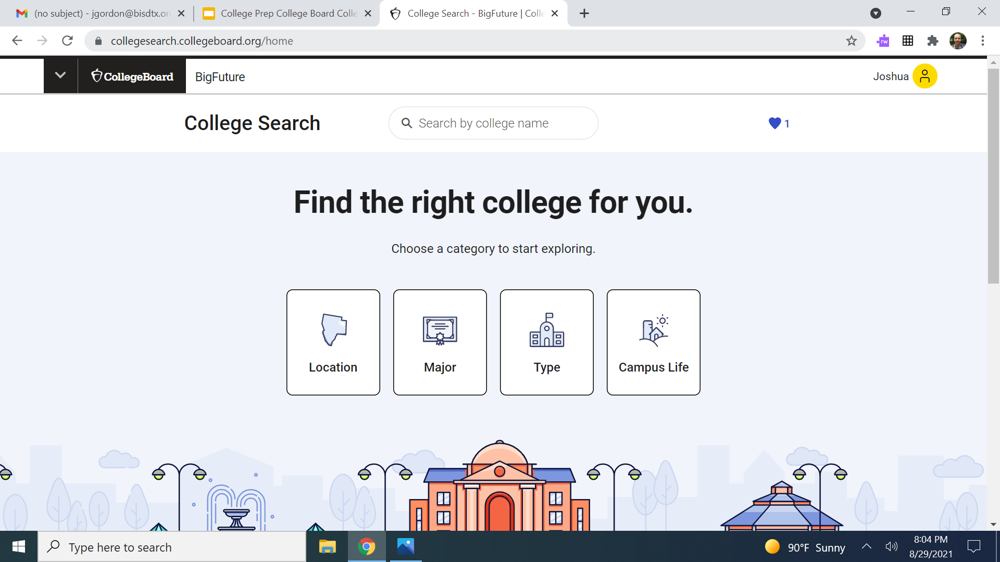
College Board: Creating Your College List
Go to https://collegesearch.collegeboard.org/home and sign in.

Slide 7
College Board: Creating Your College List
Using the four criteria, search for colleges. I recommend focusing on Location (distance from home or in Texas) and Major.

Slide 8
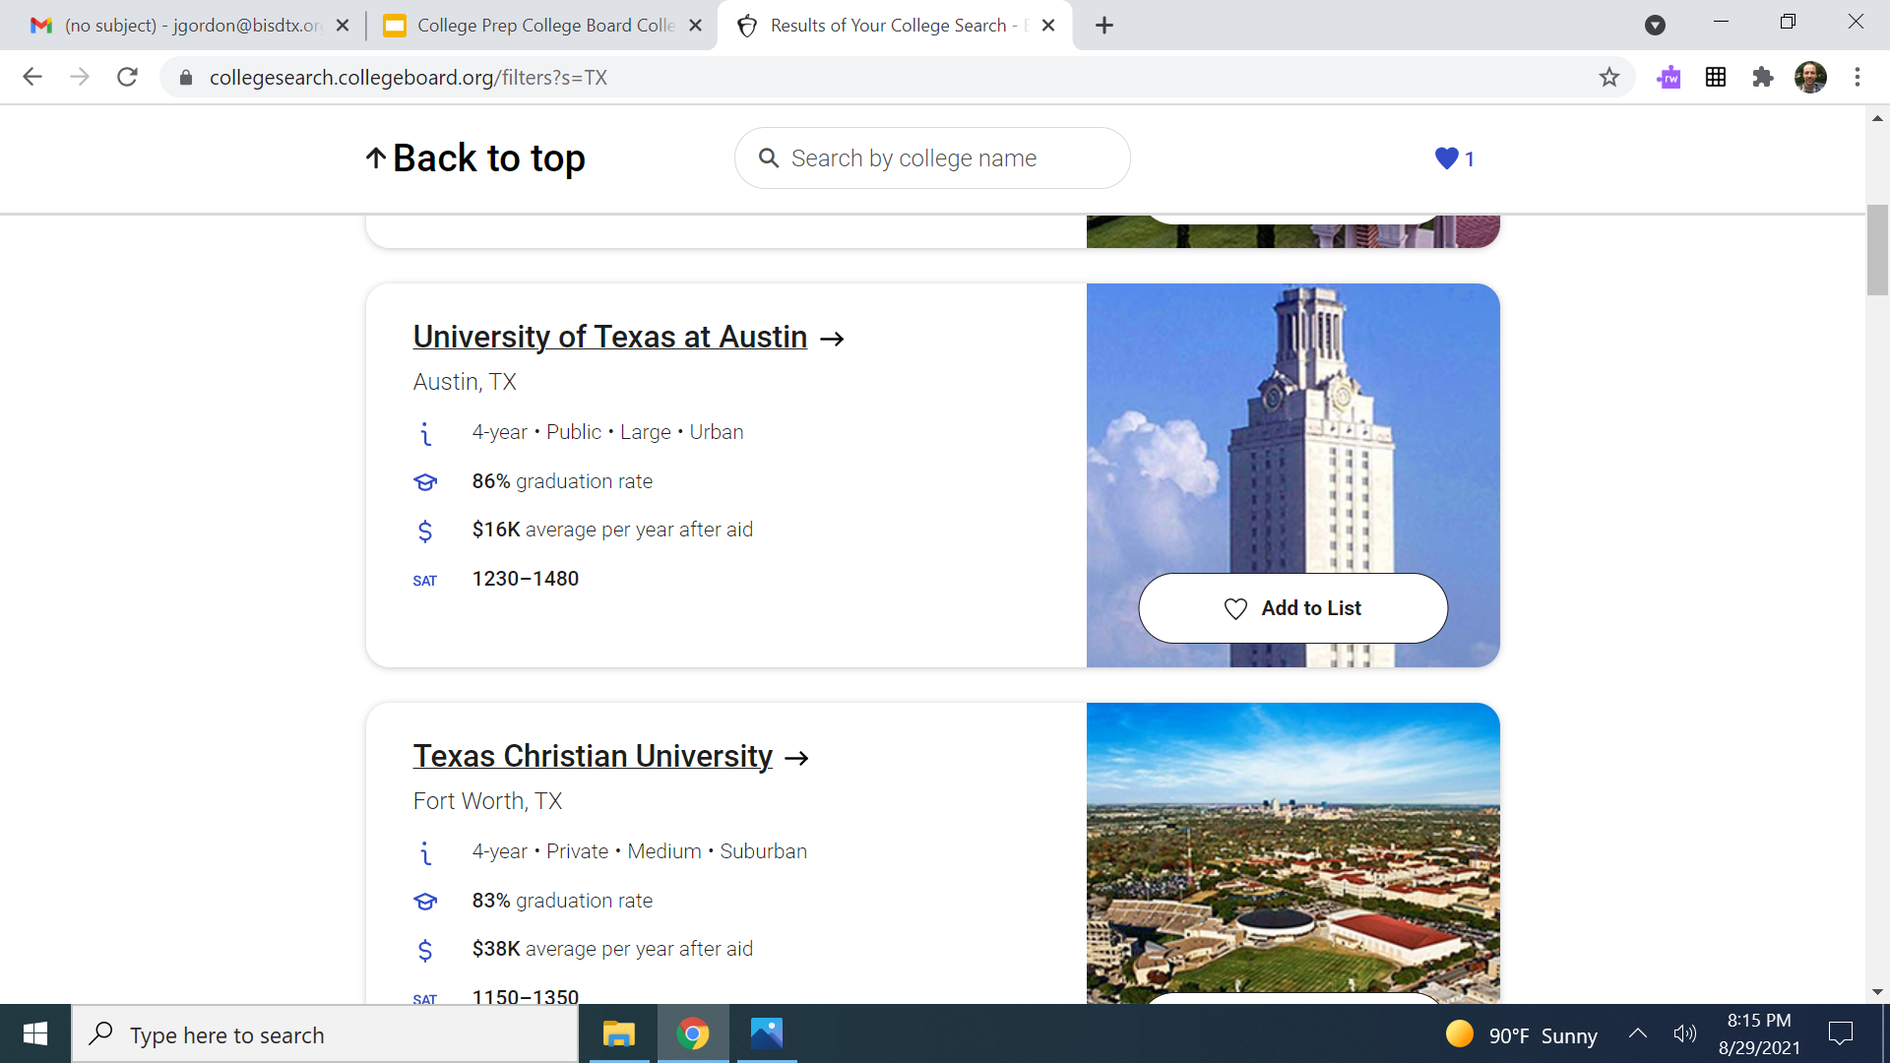
College Board: Creating Your College List
When you find a university you are interested in, add it to your List.

Slide 9
Today’s College Prep Assignment
In the comments section of today’s College Prep, write two colleges that you added to your list.

